Slide 1
Widener University
Delaware Law School
Exit Interview Counseling Presentation
Managing your student loan repayment

Slide 2
Purpose of this session
Review types of loans borrowed
Terms of loans
Consolidation
Deferment and Forbearance Options
Repayment Plans Available
Tools Available

Slide 3

Types Of Education Debt
Three Types
Federal Loans
  FFELP Stafford Subsidized/Unsubsidized
  Federal Direct Subsidized/Unsubsidized
  GradPLUS (FFELP/Direct)
Institutional Loan
  Widener Scholar Loan (merit based)
Private Loans
  New Jersey Class
  Discover, Wells Fargo, Sallie Mae/Navient

Slide 4
Stafford/Direct Loan Terms
Subsidized and Unsubsidized
Interest rate:
For loans disbursed after 07/01/2016:
Fixed at 5.31%
For loans disbursed after 07/01/2015:
  Fixed at 5.84%
For loans disbursed after 07/01/2014:
  Fixed at 6.21%
For loans disbursed after 07/01/2013:
  Fixed at 5.41%

Slide 5
Direct Subsidized and Unsubsidized Loan Terms
Grace period: 6 months
Repayment term: 10 years
Lender: Department of Education
Holder: Department of Education
Maximum amount per academic year: $20,500.00

Slide 6
Subsidized Stafford/Direct Loan Terms
Interest is paid by the government while in school, during grace periods and during deferments.
Maximum amount per academic year for graduate students was 8,500.00 for loans first disbursed prior to 07/01/12.

Slide 7
Unsubsidized Stafford Loan Terms
Interest accrues from the date of disbursement and is the student’s responsibility. It can be paid by the student while in school on a quarterly basis or can be capitalized at repayment.
Capitalization is when the amount of accrued interest is added to the principal of the loan at repayment.

Slide 8
Perkins Loan Terms
No interest accrues while in school, during grace periods and during deferment.
Interest rate: Fixed 5%
Grace period: 9 months
Repayment term: 10 years
Lender: School
Widener’s Perkins loans are serviced by
UAS (University Accounting Services)

Slide 9
Widener Scholars Loan
No interest accrues while in school, during grace periods and during deferment.
Interest rate: Fixed 5%
Grace period: 6 months
Repayment term: 10 years
Lender: School
Widener Scholar Loans are serviced by
UAS (University Accounting Services)

Slide 10
Federal Graduate Plus Loan
July 1, 2015 – to Present
Fixed 6.31 interest rate - Fees: 4.272% origination fee
July 1, 2015 – June 30, 2016
Fixed 6.84% interest rate - Fees: 4.292/4.272% origination fee
July 1, 2014 to June 30, 2015
Fixed 7.21% interest rate - Fees: 4.288% or 4.292% origination fee
July 1, 2013 to June 30, 2014
Fixed 6.41% interest rate - Fees: 4.204% or 4.288% origination fee

Slide 11
Federal Graduate Plus Loan
Has a six month post half-time enrollment deferment period (grace)
Repayment = 10 years. Options exist to extend repayment term depending on repayment plan selected and/or amount of educational loan debt.

Slide 12
Federal Direct Graduate Plus Loan
Direct GradPLUS loan servicers should not require you to request that you be put into your “Post half-time enrollment deferment”
Check NSLDS in July, 2017 to make sure you are not in repayment and if you are-Contact your servicer!

Slide 13
Private Loan Terms
Interest rate: Varies by program
Fees: Vary by program
Repayment term: Options and incentives vary by program
Check with your lender for your loan’s specific details
NJ Class Loans are state sponsored private loans. You made choices regarding interest rates and repayment option when you applied for the loan. Check your records to determine your terms.

Slide 14
Preparing After Graduation
Servicer
Grace Period
Repayment Options
Deferment
Forbearance
Loan Consolidation

Slide 15
Who/What is a Servicer?
Servicers are organizations hired by the Department of Education to service your loans.
Your point of contact for repayment
Set up an online account to monitor loan repayment, get important tax information and provide options for repayment

Slide 16
Federal Loan Servicers
Nelnet | Great Lakes Educational Loan Servicers, Inc.
Navient (formerly Sallie Mae) | FedLoan Servicing (PHEAA)
MOHELA | ESA/Edfinancial
CornerStone | Aspire Resources Inc
Granite State – GSMR | OSLA Servicing
VSAC Federal Loans | Debt Management and Collections System

Slide 17
Know Your Loan’s Grace Period
A grace period is a specified period after you graduate or leave school during which you do not have to make payments on your loan. Be sure you know it!
  The Federal grace period is 6 months and it may differ for Private Loans.
  It is included as part of the loan terms; you do not have to apply for it
  It is during this period that you will be selecting a repayment plan.

Slide 18
Federal Loan Repayment Options
Many repayment options are available
  Standard- 10-year repayment term
  Graduated - Payments start low, then increase after two years, and then after five.
  Extended - Up to 25 year repayment term, depending on total amount borrowed.
  Income Driven Repayment Plans
    Income Sensitive/Income Contingent - Payments tied to your income.
    Income Based Repayment - payments based on a percentage of Adjusted Gross income after adjusted by federal formula.
    Pay As you Earn Repayment Plan - similar to IBR
    REPAYE – similar to PAYE

Slide 19
Federal Loan Repayment Options
Standard
  10 years, level payments
  Least expensive option
Graduated
  Interest Only payments the first two years, then payment will increase to interest and small principal payment and then straight repayment
  Up to 25 years for repayment.

Slide 20
Federal Loan Repayment Options
Extended - available to borrowers with an outstanding principal of $30,000 or more
  Maximum of up to 25 years to repay
  Level or graduated payment option
  You do not need to consolidate to utilize this option.

Slide 21
Income Driven Repayment Plans
Income-driven repayment plans are designed to make your student loan debt more manageable by reducing your monthly payment amount.
Four types:
Income-Based Repayment Plan (IBR Plan)
Pay As You Earn Repayment Plan (PAYE Plan)
Income-Contingent Repayment Plan (ICR Plan)
Revised Pay As you Earn Plan (REPAYE Plan)

Slide 22
Income Contingent
The lesser of the following:
  20 percent of your discretionary income OR
  What you would pay on a repayment plan with a fixed payment over the course of 12 years, adjusted according to your income.
  Adjusted annually based on tax return

Slide 23
Income Based Repayment
Must have a “partial financial hardship” - when the annual amount due on your eligible loans, as calculated under a 10-year Standard Repayment Plan, exceeds 15% of the difference between your AGI and 150% of the poverty line for your family size in the state where you live.
IBR Plan for those who are not new borrowers* on or after July 1, 2014
  Generally 15 percent of your discretionary income, but never more than the 10-year Standard Repayment Plan amount
IBR Plan for those who are new borrowers* on or after July 1, 2014
  Generally 10 percent of your discretionary income, but never more than the 10-year Standard Repayment Plan amount.
If balance remains after 25 years, it is forgiven. Currently count as taxable income.
*For IBR, you are a new borrower if you had no outstanding balance on a William D. Ford Federal Direct Loan (Direct Loan) Program loan or Federal Family Education Loan (FFEL) Program loan when you received a Direct Loan on or after July 1, 2014.

Slide 24
Pay as you Earn
Must be a New Borrower as of Oct 1, 2007.
Must have had a Direct Loan disbursement after Oct 1, 2011.
Only available if all loans are Federal Direct Loans.
Must have a “partial financial hardship”
Works the same as Income Based Repayment using 10%
Monthly payments are set to 10% of monthly discretionary income.
  Payment will never more than the 10-year Standard Repayment Plan amount.
If balance remains after 20 years, it is forgiven. Currently count as taxable income.
Available as of December, 2012

Slide 25
REPAYE
Opens up PAYE/New IBR plans to borrowers who were not formerly eligible
No partial financial hardship needed
10% of discretionary income, divided by 12,unless the monthly payment amount is adjusted under the “catch‐up” provision under 685.209(c)(4)(vii)(E)
No 10‐year standard “payment cap” (i.e., payment can be higher than what it would be under the 10‐year standard plan)
Discretionary Income- same as original IBR
Remaining balance forgiven after:
• 20 years of qualifying repayment for borrowers whose loans being repaid under REPAYE include only loans received as undergraduate or a consolidation loan that repaid only loans
borrowers received as undergraduate
• 25 years of qualifying repayment for borrowers whose loans being repaid under REPAYE include a loan received as graduate or professional student or a consolidation loan that repaid a loan received as a graduate or professional student.
Available as of December, 2015

Slide 26
Student Loans.gov
Department of Education website http://studentloans.gov
Repayment Estimator available-uses information from NSLDS.
Remember, interest has not been capitalized at this point so repayment amount are estimates only.

Slide 27
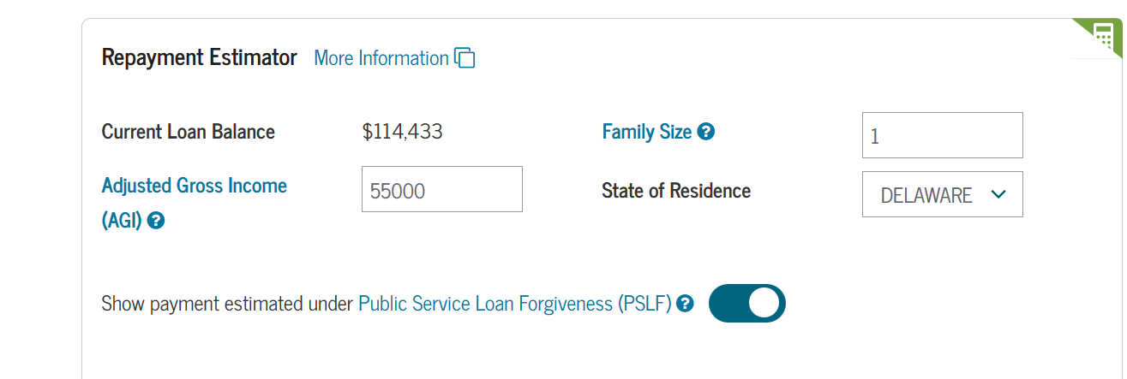
DOE Calculator uses these data points:
AGI = 55,000; family size of one. (you input)
DOE assumptions – 5% salary increase yearly; no change in family size

Slide 28
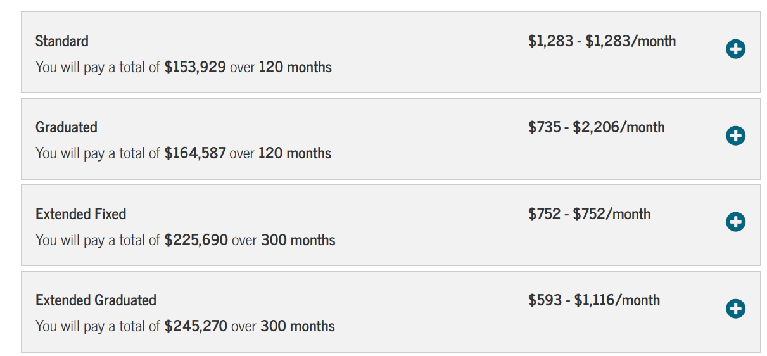

Slide 29
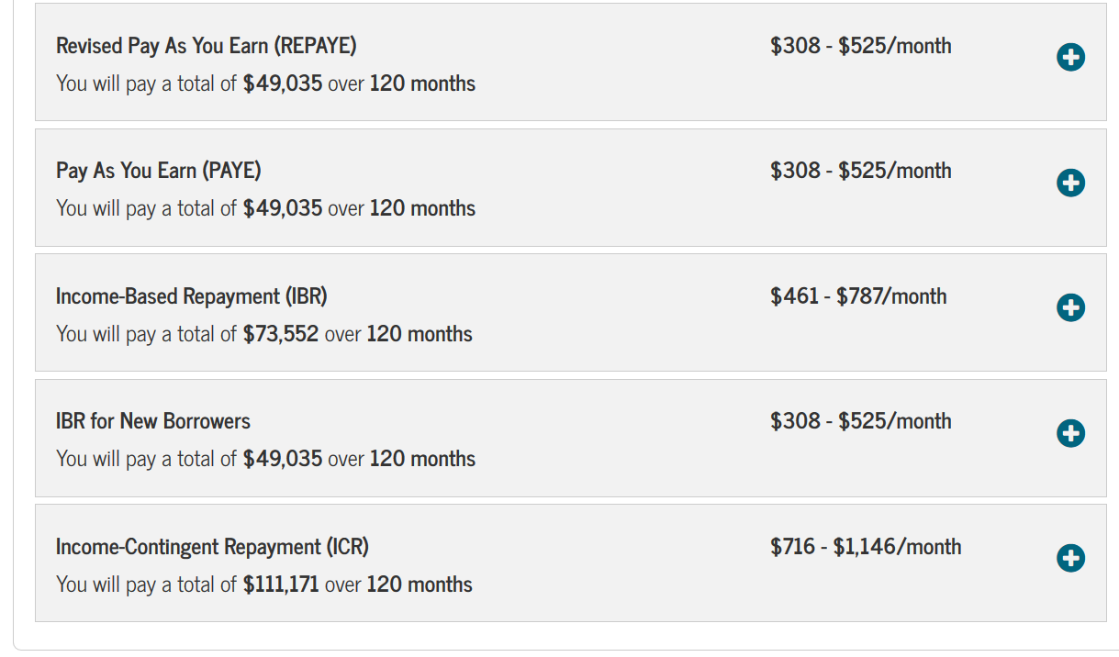
Income Driven Repayment Plans

Slide 30
Repayment Examples
Debt - $114,433
Stafford - $61,500
GradPLUS – $52,934
Standard
Payment - $1,283 for 120 months
Total Payments - $153,929
Total Interest – $39,496

Slide 31
Repayment Examples
Extended, Fixed 20 year
Payment - $837 for 240 months
Total Payments - $200,778
Total Interest – $86,345

Slide 32
Repayment Examples
Fixed, Extended – 25 years
Payment - $752
Total Payments – $245,270
Total Interest - $130,837

Slide 33
Income Based Repayment
Example
Total Loan Debt - $137,614
  Stafford – $61,500
  Grad Plus – $76,114
Estimated Monthly Loan Payment
$ 1553 ( 120 Months)

Slide 34
Income Based Repayment
Example
Total Annual Payment (10 year repayment) - $18,636
Household size - 1
Household Adjusted Gross Income - $55,000
HHS Poverty line for Household size - $12,060
150 % of Poverty Line - $18,090
Household AGI – 150% of the Poverty line - $36,910
15% of AGI above the Poverty Line - $ 5,536
Eligible for Income Based Repayment - YES

Slide 35
Income Based Repayment
Example
15% of AGI above the Poverty Line - $5,536
Standard Monthly Payment - $1,553
Income Based Monthly Payment - $ 461
(5,577 divided by 12 months)

Slide 36
Pay As You Earn Repayment Example
Household size 1
Household Adjusted Gross Income $ 55,000
HHS Poverty line for Household size $ 12,060
(Dept of Health and Human Services)
150 % of Poverty Line $ 18,090
Household AGI – 150% of the Poverty line $ 36,910
10% of AGI above the Poverty Line $ 3,718
Eligible for Income Based Repayment YES
10% of AGI above the Poverty Line $ 3,691
Standard Monthly Payment $ 1,553
Income Based Monthly Payment $ 308
(3,718 divided by 12 months)

Slide 37
Monthly maximum payments (2015) IBR
AGI - (assumes family size of 1)
  $30,000 $160
  $40,000 $285
  $50,000 $410
  $60,000 $535
  $70,000 $660
  $80,000 $785
  $90,000 $910
  $100,000 $1,035

Slide 38
Income Driven Repayment Plans
Positives
  Allows borrower to have reasonable payment tied to income
  Any payment on a loan is better than paying nothing (forbearance)
Pitfall
  Negative Amortization- when required loan payment does not cover accruing interest

Slide 39
Benefits of
Income Based Repayment Plans
Payment: Monthly payment amount less than 10-year Standard repayment plan.
Interest Payment Benefit: Government will pay unpaid accrued interest on Subsidized Stafford/Direct loans for up to 3 consecutive years from date begin repayment under IBR.
25-Year Cancellation: If repay under IBR plan for 25 years and meet certain other requirements, any remaining balance cancelled.
20-Year Cancellation: If repay under Pay As You Earn plan for 20 years and meet certain other requirements, any remaining balance is cancelled.

Slide 40
Disadvantages of
Income Based Repayment Plans
You Will Pay More Interest: Faster you repay loans, less interest you repay. Reduced monthly payment generally extends repayment period creating more interest over life of the loan.
  Negative Amortization: when required loan payment does not cover accruing interest.
Taxable Income: Amount cancelled is taxable income.
You Must Submit Annual Documentation: To set payment amount each year, loan servicer needs updated information about income and family size.
  If not provided, will be required to pay monthly amount under 10-year Standard repayment plan.
  Amount will be based on amount owed when began repaying under IBR or Pay As You Earn.

Slide 41
REPAYE – Pros/Cons
PROS
  Gives borrower an alternative to ICR if not eligible for IBR/PAYE
  Loan Forgiveness after 25 years with graduate debt.
CONS
  No 10‐year standard “payment cap” (i.e., payment can be higher than what it would be under the 10‐year standard plan)
  Catch-up provisions – tricky to understand

Slide 42
Deferments and Forbearances
If you are experiencing difficulties repaying your loans and need to postpone or suspend repayment deferments and forbearances are available.

Slide 43
Deferments
A deferment is a specified period when a borrower may temporarily suspend loan payments if certain criteria are met.
  You must apply for it – contact your servicer
  Interest on subsidized loans does not accrue when in a deferment

Slide 44
There Are Many Types Of Deferments
For Federal Stafford and GradPlus loans, the following deferments are available:
  In-School
  Unemployment
  Graduate Fellowships
  Rehabilitation Training
  Economic Hardship
  Military Service (vary by type and timing of service)
  ** Deferments also apply to Federal Consolidation Loans

Slide 45
What Is Forbearance?
Forbearance is an agreement to temporarily suspend or reduce loan payments for a limited period of time.
Helps avoid delinquency and default
Will not adversely affect credit reports
Must be applied for on an annual basis
Carries a 3-year maximum time limit
Loan interest will continue to accrue and must be paid or be capitalized

Slide 46
Temporary Hardship Forbearance
Lenders offer a temporary hardship forbearance.
Up to 12 months on your signature.
May use to align repayment of your loans

Slide 47
Consolidation Can Work To Your Benefit or Not
With Whom
  William D. Ford Direct Lending Program
Why
  Convenience of one lender/servicer
  Lower monthly payments (will result in a larger total payment over time)
  Fixed interest rate based on weighted average of underlying loans interest rates, rounded to 1/8%
  Ability to participate in Public Service Loan Forgiveness Program with Direct Consolidation Loans

Slide 48
Consolidation Considerations
  Variable vs. fixed interest rate loans
  Fixed Interest Rate loans rounded to next 1/8%
  Interest rates no longer capped at 8.25% (July 1, 2013)
  Not necessary if all of your loans are Federal Direct Loans – loans should already be at one servicer.
  Where: http://www.studentloans.gov
    You will be able to pull your loan information from NSLDS to help you complete your application.

Slide 49
NSLDS – National Student Loan Database System
To find Federal Stafford, Perkins or GradPLUS loan information, visit www.nslds.ed.gov
The website will provide information on:
  Loan Amounts
  Lender Addresses
  Loan Periods
  Interest Rates
You’ll need your four-digit PIN from the FAFSA to access your records. If you cannot remember your PIN, you can request a reminder
For information on private/alternative loans, please
check your records or visit your lender’s website.

Slide 50
Additional Tools available
Your servicer’s website
  Many offer repayment calculators, budgeting tools and mobile apps to help you mange repayment.
AccessLex Institute-”AccessConnex” –provides free information if you have questions regarding loan repayment options.

Slide 51
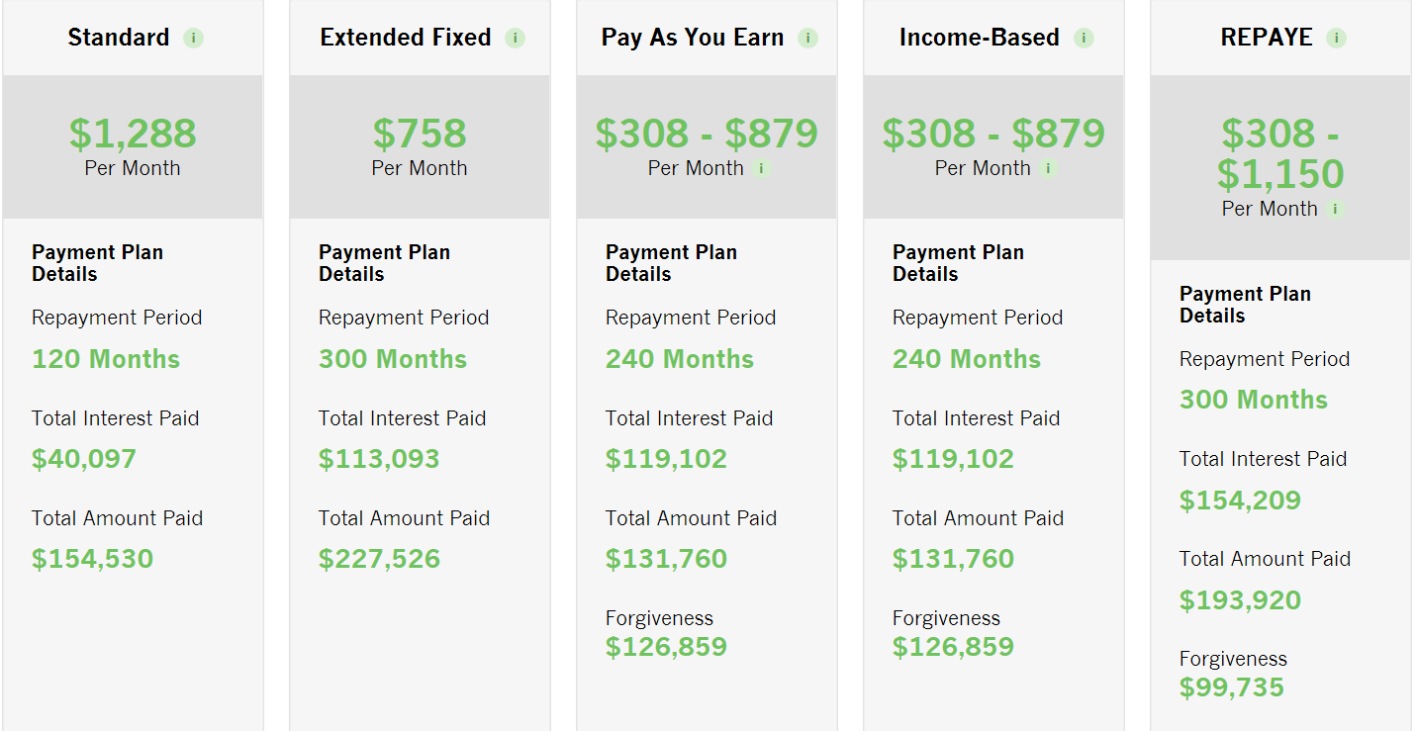
AccessLex Repayment Calculator & Budgeting Tools

Slide 52
Public Service Loan Forgiveness
To qualify for public service loan forgiveness, a borrower must:
Make 120 qualifying monthly payments on an eligible Federal Direct Loan on or after Oct. 1, 2007;
  • Be employed in a public service job as defined in the CCRAA during the time he or she makes the qualifying monthly payments;
  • Be employed in a public service job as defined in the CCRAA at the time the Secretary of Education forgives the loan; and
  • Make qualifying payments under one (or a combination of) the following:
    o Income contingent repayment plan;
    o Income-based repayment plans
    o Standard repayment plan with a 10 year repayment period; or
    o One of the other Direct Loan repayment plans under which the borrower paid a monthly amount that is not less than what the borrower would pay under a 10 year repayment plan.

Slide 53
Public Service Loan Forgiveness Program
Must have loans in a Direct Loan
Can consolidate FFELP into Direct for this program
Must make 120 qualifying payments while in a qualifying position. (no doubling up)
A zero payment counts as a payment

Slide 54
Public Service Loan Forgiveness
Employer Certification form is available at FedLoan Servicing – allows borrower to have eligible employment certified and on file with DOE servicer.
By submitting form, borrower can registers intent to participate in PSLF and loans will be moved to one servicer, FedLoan Servicing, that will keep track of eligible payments.

Slide 55
Federal Loan Repayment Etc.
Borrowers can prepay their federal loans with no penalty.
Payments with a shorter repayment period save money.
Borrowers can move between the various repayment schedules without penalty.

Slide 56
Private Loan Repayment Options
Standard, Graduated and Extended.
Depending on your lender, length or repayment can range from 10 to 25 years.
Timing of repayment begin date will depend on your lender and terms of your loan.
Check with your lender!

Slide 57
Delinquency
Delinquency is the failure to make payments when due.
Reflects adversely on your credit report.
Once you are delinquent for 360 days, you go into default.
Contact your lender immediately to explore payment options if you become delinquent.

Slide 58
Default
Default is the failure to repay educational loans.
Reflects adversely on your credit report
Wages may be garnished
May lose federal and/or state income tax refunds
Suspends future borrowing ability
May lose professional licenses
Must repay the entire loan immediately
May be referred to a collection agency

Slide 59

Tips For Success
Be organized!
Read and understand all correspondence from lenders and servicers.
Save copies of all student loan records, correspondence and payment receipts (paper or electronic).
Contact your lender or servicer to request a deferment, apply for a forbearance, or with any questions you may have.
No penalty for pre-payment on Student Loans

Slide 60
Tax & Borrower Benefits!
Consult your tax advisor for details
Lifetime Learning Credit
Student Loan Interest Deduction
Tuition/Fees Deduction
Repayment Incentives for Federal/Private Loans
Direct Withdrawal
Co-signer release
Consult your lender for details

Slide 61
Contact Information
Eleanor Kelly
Director of Financial Aid
302-477-2272
lawfinaidde@mail.widener.edu
Questions now or anytime in the future

